Slide 1
AUTISM 300
Sign In
Pick up a folder
Find a seat
Meet your neighbor

Slide 2
Getting Started
Go to… www.cooperativeschoolservices.org
Select Information and then Trainings

Slide 3
THE GOAL
To learn strategies for teaching reading comprehension to students who read but don’t comprehend.
Who are these students…
  Students with ASD
  Students with Hyperlexia
Notes:
Introduction of self and introduction of others and grade levels being taught. We will be covering a lot of material today.
We are going to be looking at recent research and new information about strategies that have been demonstrated to be beneficial for students who read words but do not understand what they are reading.
The main concept we want to convey today is that
Reading Comprehension is interacting with text. When you leave today, the hope is you will have learned some techniques that research has shown improves students’ ability to interact with text.
There are two themes that will be weaved through the day…
1.) When teaching students who are not “naturally good” readers, Pictures are often more meaningful than words. And
2.) Technology is more motivating than worksheets or writing.
So… our plan…
Between now and about 9:15, we will be accessing your prior knowledge. We will be briefly reviewing characteristics of students with ASD, analyzing the skills actually required for reading and thinking about how the developmental differences of students with ASD impact comprehension.
In the time between the break and lunch, we will be looking at the strategies that research has shown are most effective in improving comprehension for students with ASD.
After lunch, we will explore strategies for teaching vocabulary that appear to have promise for students with ASD and we will conclude the day with ways to use visual strategies.

Slide 4
Autism Criteria in DSM-5
A.) Deficits in Social Communication & Social Interaction…need 1, 2, and 3:
1.) Deficits in social-emotional reciprocity.
2.) Deficits in nonverbal communication for social interaction. e.g. eye contact/body language
3.) Deficits in maintaining relationships at appropriate developmental level.
B.) Plus Restricted Repetitive Behavior patterns:
Need two of the four: 1.) Stereotyped or repetitive motor movements, use of objects or speech 2.) Restricted routines/rituals 3.) Fixations 4.) Hypo or hyper reactivity to sensory input
C.) Symptoms must be present in early developmental period.
Notes:
Notice there is no mention of IQ or intellectual ability.
The population we will be discussing today does not have significant cognitive delays. Some have areas of strength and challenge, others are gifted intellectually and/or academically – but they still meet the criteria for ASD due to challenges in these areas.

Slide 5
CDC Stats
Increases in the last 20 years
CDC March 2012 data: 1/88
CDC March 2014: 1/69
CDC April 2016: 1/59
CDC 2018: 1/44
Notes:
A few “facts and figures”
The CDC ASD homepage lists these facts and figures. CDC felt there was some stabilization b/w the 2014 and 2016 collection but not saying that yet. Based on tracking 8 year olds with med dx of ASD, school eligib. Or international diagnosis. Boys 4.2 times more likely than girls. MO & CA expample.
Part of the reason for the increase is our better understanding of how widespread these social communications disorders are. However, Dr. Paul Wang at Autism Speaks is quoted as saying “We believe that there is a very real increase in Autism cases that cannot be fully attributed to changes in diagnostic awareness.”

Slide 6
Autism Spectrum Quotient
https://psychology-tools.com/autism-spectrum-quotient/
Notes:
I’m sure you have all heard we are all on the spectrum somewhere. So – let’s take a quick quiz to see how we fair.

Slide 7
Current Research
  Gene variants (malfunction in myelin production)
  Environmental factors
  Exposure to toxins
  Intestinal Microbiome (gut bacteria)
  Neurotypes (multi-years study funded by CDC)
Notes:
There is a genetic susceptibility for ASD, with a combination of genetic and environmental factors. It is not passed on like hair color. There are about 100 genes that have been tied to Autism or to its hallmark behaviors but no one gene mutation causes the disorder. 2018 article discusses abnormal white matter in the social areas of the brain.
Multi year study by CDC
Alabama 1 in 175
New Jersey 1 in 46

Slide 8
What is ASD?
It’s a social communication disorder that is…
  Neurodevelopmental in origin (inefficiencies in some areas of the brain and nervous system)
  Differences in development not just delays
  Present across the lifespan
Notes:
Complex disorder of the CNS. ASD predominantly involves and/or affects the CNS. Students with ASD are wired differently. There is a wide range of severity hence the spectrum term of the disorder. (Siblings don’t even show the same gene abnormalities.)
How many of you have had the chance to go to the training in Bloomington?

Slide 9
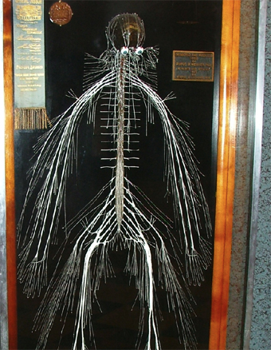
Harriet Cole
Notes:
She cleaned at Drexel College of Medicine where she donated her body to science. Dr. Rufus B Weaver dissected her CNS. It took 5 months.

Slide 10
Characteristics that can impact Reading Comp
Awkwardness in communication despite strong vocabulary and grammar.
Difficulty “reading” the behavior of others.
A preference for predictability.
A tendency toward specific and intense interests.
Notes:
Additional challenges can include: Challenges integrating sensory information
Behaviours similar to ADHD – extraneous noises, movements
Fine motor skills – very challenging or very precise
Gross motor coordination is often a challenge
Anxiety – perfectionism
Obsessive-compulsive behaviors

Slide 11
Leading Researchers
Emily Iland
  E. Iland (2011). “Drawing a blank”
Paula Kluth
  P. Kluth & Chandler-Olcott (2007). “A land we can share”
Michelle Garcia-Winner
  M. Garcia-Winner (2000). “Inside Out”
Notes:
The Co-op conducts a survey every year to see what in-service needs teachers have are. About 5-6 years ago, a need for teaching reading comprehension to students with ASD emerged as an area of interest.
Both Michelle Garcia-Winner and Paula Kluth have wonderful insights on teaching students with ASD. Their insights on the deficits in social cognition and sensory issues as well as challenges with reading comprehension are very important.
Research conducted by Emily Iland has been integrated into this workshop. Her work focuses more intensely research and strategies to teach reading comprehension.
Today, we will be referencing all three, but the primary focus will be on the work of Emily Iland.
She is the mother of a son with Asperger’s. She tells her story at the beginning of her workshop and in her book, Drawing a Blank. Her son was a precocious reader from the age of 3. By 4th grade, though, he began having trouble understanding the text he was reading so fluently. Her book is the result of her experience with her son and her own return to school to earn a master’s degree in special education. She has studied research findings about teaching reading and reading comprehension.

Slide 12
Profile During Primary Grades
Good decoding and fluency
Understanding of concrete facts
Good memory
Superficial understanding
Use of short or limited responses
Notes:
While we will be focusing on reading comprehension problems that emerge in intermediate grades, we need to take moment to focus on the traits of these students that may have caused us to miss an emerging problem with comprehension.
We notice when primary students are having difficulty with word decoding.
We may miss students who developed the ability to recognize words and word call fluently.
An emerging problem during primary years may also be masked due to parental efforts in reteaching at home or through private tutoring.

Slide 13
Warning Signs
The student reads well, but…
  Has difficulty with phonemic awareness or letter-sound fluency
  Has difficulty with grade-level oral language skills
  Has difficulty translating text into spoken language
Notes:
However, now we know there are early warning signs.
The student is relying on visual memory… interesting letter configurations, not attending to word meaning
Difficulty acquiring vocabulary and oral language needed for social interaction and conversation – may be difficult to identify because of wealth of knowledge in areas of interest. Watch for difficulty with multiple meaning words, homographs and words with connotation
Difficulty retelling, sequencing, answering questions and expanding on answers (why…how…)

Slide 14
ASD & Reading Comprehension
Decoding + Comprehension = Reading
Decoding – Comprehension = Hyperlexia
FOOTNOTE: Research studies on strategies for teaching reading comprehension have rarely included students with ASD in the research sample.
Notes:
I was amazed to discover that the National Reading Panel in its extensive review of effective instructional methods intentionally eliminated all studies that focused on populations with special needs.
Mrs. Iland states that there is almost no research that compares the effectiveness of different techniques for students with hyperlexia or ASD.
What research there is, she presents in her book.
Even more interesting is that the research included very few children with autism in each sample – and how many had moderate cognitive deficits. Reading techniques were being used to enhance their development of oral language.
Clearly, we need to exercise good judgment when choosing strategies for our population.
I’ll give a brief overview of the strategies that have been found to be effective today.

Slide 15
The Reading Process
“a complex system of deriving meaning from print” (NCLB)
Requires direct instruction in
  Phonemic awareness
  Phonics
  Vocabulary development
  Fluency development
  Reading comprehension
Notes:
To understand why reading comprehension can be so challenging for students with ASD, we need to look closely at the reading process.
In 2001, NCLB and its Reading First initiative has been researching effective instructional methods in these 5 areas.
These skills do not necessarily develop in a linear fashion.
Some students learn to recognize the word – a phonics skill – and learn its meaning – a vocabulary skill - at the same time.

Slide 16
Good Readers
Use the author’s organizational plan to think about information
Monitor their own comprehension actively and effectively
Interpret information through the filter of their own knowledge and beliefs
Infer what the author does not tell explicitly
Read with purpose and motivation
Notes:
Reading is a dynamic process. Good readers interact with the content and the author. You can see why students with autism have challenges.
A student with ASD who has strong decoding skills, good memory for facts and understanding of concrete content may not be perceived as having a comprehension problem during primary years.
Mrs. Iland’s experience is most likely similar to our experiences in that significant reading comprehension challenges with students who have good word recognition skills begin to surface around 4th grade.

Slide 17
Socialization
Three key social skills are not developed spontaneously in students with ASD…
  Joint attention
  Shared enjoyment
  Imitative play
Notes:
So, how do differences is the development of students with ASD impact reading?
Reading is a social interaction process.
Child development experts believe that play is where learning and literacy begin.
To varying degrees, children with ASD do not spontaneously develop 3 basic skills.
Joint attention is paying attention to a shared object – looking in the direction someone is pointing – joint attention is basic in story reading time with a parent. In school, it is essential to follow a teacher’s directions. Can anyone share with the class an example of joint attention?
Shared enjoyment is enjoying an item or interest because of the response or reaction of the other person – checking for reactions. Shared enjoyment indicates the ability to understand the emotions or reactions of another person. Another foundational skill for understanding perspective when reading. Can anyone share and example of shared enjoyment?
Imitative play involves “mirroring” others. Watching, copying actions and words of others in the environment. Children practice real-life social situations, again a foundational skill for understanding social interactions in real life and in text. The student may not practice words and actions in real-life social situations and, as a result, have difficulty understanding them in stories. The student may also have difficulty creating visual images when reading because content is unfamiliar or fantasy. Re Can anyone share an example of imitative play?
Less interaction with others also impacts vocabulary development as vocabulary and word meaning are built through oral language experiences.

Slide 18
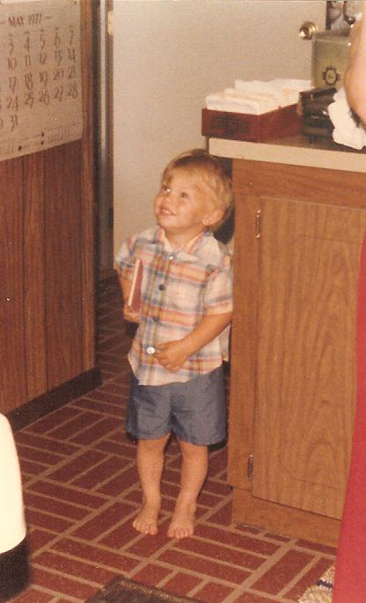
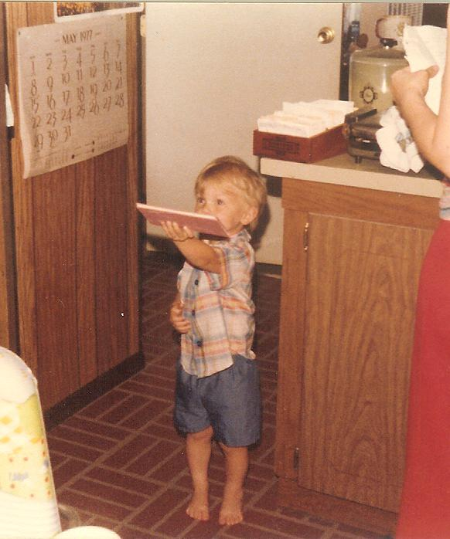
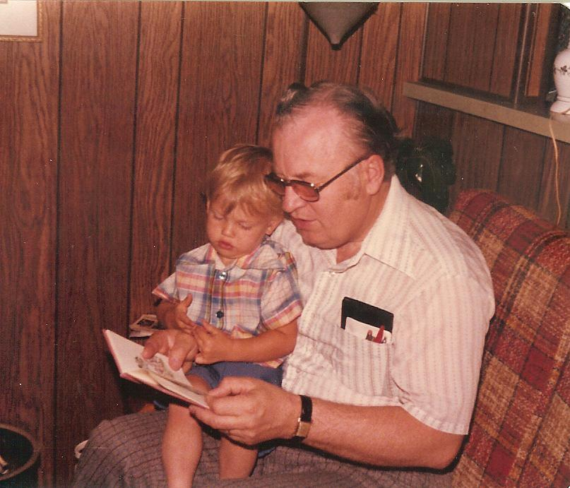

Slide 19
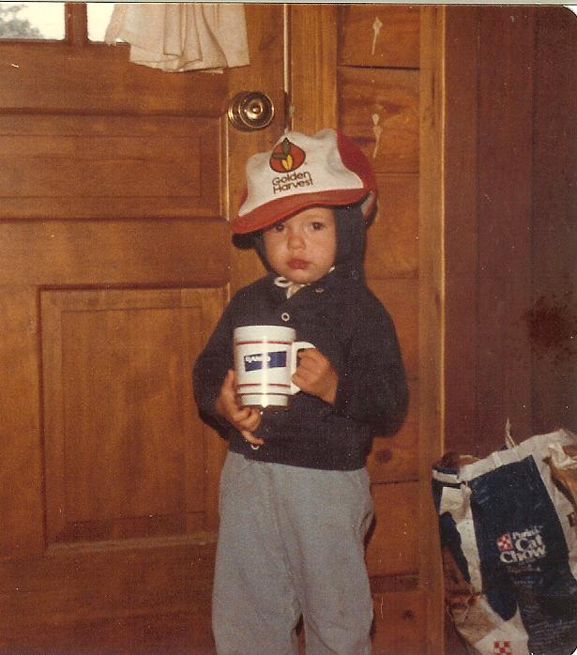
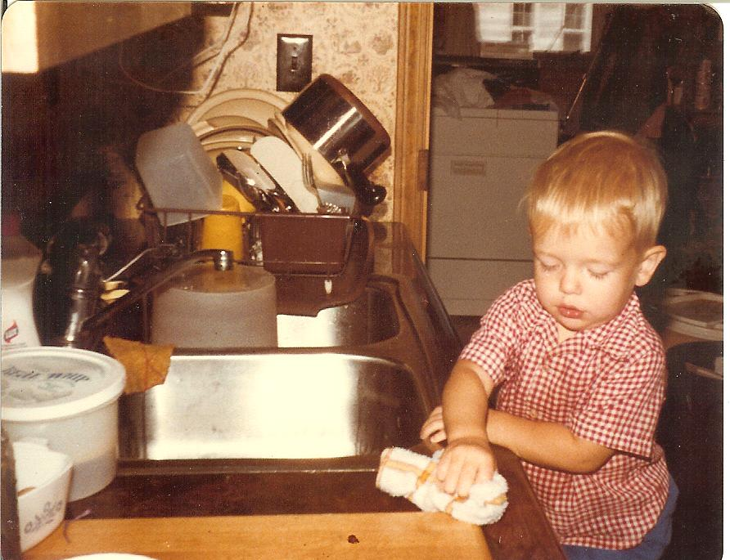

Slide 20
Impact on Reading Comp
Limited vocabulary development
Limited ability to understand perspective or the feelings and emotions of others
Difficulty understanding cause-and-effect
Difficulty creating visual images when reading
Notes:
The social challenges of students with autism impact reading vocabulary in a variety of ways. Globally it affects the students ability to spontaneously learn these things through their environment.

Slide 21
Restrictive & Repetitive Interests
Even with exposure to a rich variety of experiences, lack of interest may limit the benefit of those opportunities resulting in a “poverty of experience”
Intense interests limit the development of a general fund of knowledge on a wide range of topics as well as the language and social relationships that go with them.
Notes:
Most people have a “shallow but wide” fund of information. A general interest in most subjects and ability to converse briefly on a wide range of topics in areas like science, literature and history or geography.
Due to their restricted and repetitive interests, students with ASD have a “narrow and deep” fund of information. This impacts conversation, vocabulary, word knowledge and world knowledge.

Slide 22
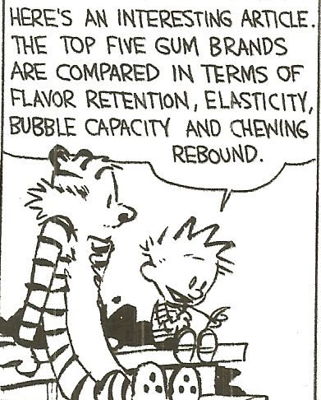

Slide 23
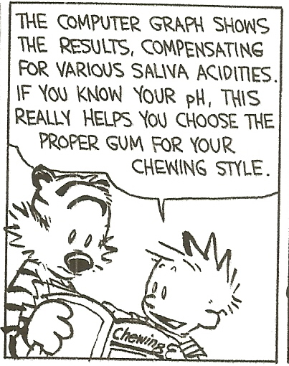

Slide 24
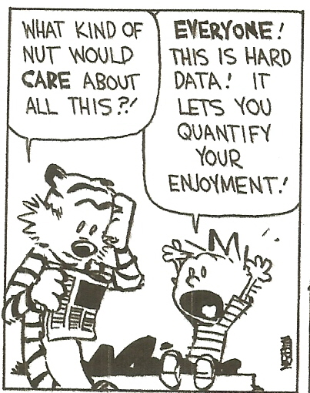

Slide 25
Language/Communication Deficits
Deficit in declarative knowledge
Deficit in vocabulary development
Literal use of language
Difficulty generalizing
Notes:
Declarative knowledge is knowing “that” – “that” the capital of Indiana is Indianapolis. If the range of interests is restricted, a student may know everything conceivable about dinosaurs or trains but have no declarative knowledge about areas that have just not been interesting…. Music, literature, travel… and factual information or background knowledge in those areas is needed to understand the vocabulary and meaning of what is read.
This information is based on prior experiences and activated while reading. Without that knowledge, the student with ASD has nothing to draw on to understand material outside the area of interest.
Vocabulary development is also impacted as the student is has an extensive, sophisticated vocabulary in areas of interest, but does not talk with others on other topics, does not participate in social activities in areas outside those of interest and does not follow the interests or conversations of others.
Rigid behavior results in literal interpretation of language, difficulty generalizing a concept to a new situation and difficulty understanding words with multiple meanings.

Slide 26
Language/Communication Deficits
Receptive language
Expressive language
Nonverbal language
Social relationship language
Notes:
Communication and language issues in students with ASD may involve a range of skills. As we discussed earlier, the language deficit is related to the lack of social interaction or play and the restricted range of interests. The language deficit impacts reading, though, because reading is a language-based skill.
Comprehension needs to occur at the word, sentence and text level.
Literal interpretation of language, difficulty with multiple meaning words and lack of familiarity with idioms impact readers with ASD at all levels.

Slide 27
How Deficits impact Reading Comprehension
Use of context
Pronouns
Questioning
Auditory processing of oral language
Notes:
Context: necessary to learn the meaning of unfamiliar words. Especially an issue with homographs – words that are spelled the same way but pronounced differently and have different meanings. Emily Iland cites a study (Wahlberg, 2001) that demonstrated that students with ASD do not self-monitor and self-correct when the wrong pronunciation is selected. We will be addressing this as we teach homographs.
A key signal that a student is word calling is that they mispronounce a word and continue reading without monitoring their comprehension. As a result, even though they have been exposed to the word, it is not added to their vocabulary or remembered.
Pronouns: understanding to whom the pronouns refer – anaphoric cuing – a significant issue for students with ASD that we will discuss in greater detail later.
Questioning: As we mentioned earlier, good readers question before, during and after reading. Students with ASD have difficulty generating questions, asking themselves if they understand what they are reading. They especially have difficulty generating “why” and “how” questions.
Auditory comprehension of language: Research cited by Iland from The Children’s Hospital of Philadelphia (2010) found that children with ASD had a response delay of 11 milliseconds in processing sounds heard in words. Seems brief, but it means that the student with ASD is processing the first syllable of a word while a neurotypical student has heard the entire word.
In neurotypical children, exposure to language helps children grow their vocabulary and word meaning but, for children with ASD, exposure alone is not enough when auditory processing delays interfere with their ability to benefit from the exposure.

Slide 28
So what should we do?
Identify a team
Identify the student’s learning style
Investigate research-based practices
Implement the practices that appear most suited to this/these student(s)
Monitor effectiveness and return to Step 3 as needed
Notes:
Let’s take a couple minutes to complete the “what’s your learning style” Something you can use to identify your own student’s learning styles.

Slide 29
Evidenced-Based Practices
Noticing and relating the content to the title
Pre-teaching basic factual concepts
Multiple, thematic exposure
Explicit instruction of idioms
Anaphoric cuing
Visualizing through drawing and writing
Notes:
Avoid strategies that are NOT a good fit to ASD
Not recommended:
Dictionary definitions Why?
Having students read text and answer questions (not an instructional method) Why?
May not work (O’Connor and Klein, 2004)
Activation of prior knowledge Why?
Cloze task Why?
In her book, Iland cites 5 important studies that included students with ASD who decode well. The studies concluded that these 6 techniques improved comprehension. The research did not explicitly state how these skills should be taught, though.
To facilitate the application of these practices, initially choose an easy text/book at an easy reading level
So, I did the first thing they teach us – when introducing a new skill, use text that is at an easy reading level and in an area of interest.
Today we are going to look at using Charlotte’s Web to practice these strategies.
I’m going to show you the techniques and then we’ll apply them to the beginning of a literature lesson on Charlotte’s Web.

Slide 30
EBP 1
Noticing & relating content to title…
  Provide a clear title for a passage that does not have a title
  Review the passage to determine if given title is relevant
Notes:
Students with ASD have difficulty activating prior knowledge, a first step in preparing to read a passage. One study found that activated prior knowledge was “bizarre or incorrect” rather than relevant. Readers with ASD needed multiple cues to make relevant connections and take advantage of background knowledge. (Wahlberg 2001).
KWL (know-want-learned) charts may not be as effective due to difficulty knowing what prior knowledge to access or to lack of prior knowledge due to lack of personal experience.
When a title is attached that tells what the paragraph will be about, the passage is disambiguated or clarified.
If a title is ambiguous, make it clear.
Research has shown that informative titles improve comprehension.
The nice thing about children’s books is that most of them have titles for chapters. Mark Twain did not title his chapters.
I’m going to be combining this strategy with the next as they both recommend preparing primer passages.
Charlotte’s Web – discuss title of book and title of chapter 1.

Slide 31
EBP 2
Pre-teaching basic factual concepts…
  For narratives, provide relevant facts central to the plot, setting, characters, conflict, emotional content or historical context
  For expository text, provide and discuss key ideas to be learned
Notes:
Pre-teaching can be done through teaching specific facts that will be key to understanding the passage. While reading, understanding the main ideas is reinforced. Our students with ASD need to understand what is relevant and what ideas are less important.
For some students with ASD, listings of relevant facts are especially helpful.
Let’s read chapter 1 and decide what you would want to pre-teach.
Now: Make a list of what you would to pre-teach based on Chapter 1

Slide 32
EBP 2 cont.
Pre-teaching basic factual concepts…
  Prepare a primer passage that contains all of the main ideas of the passage to be read
Notes:
Primer passages are another technique. This is a basic, facts-only passage that creates a concrete understanding of the main elements of the story. It does not use the numbers and list format.
Primer passages in research have generally been about 275 words – succinct and relevant.
What key information do you want in your primer passage?
Primer passages- just the facts
Tip: ELL materials often contain primer passages

Slide 33
Preparing a Primer Passage
Teacher prepares a short passage on a transparency, whiteboard or smartboard
Teacher and students read the passage together
Students identify key words. Teacher circles them. Group works together to clarify meaning.
Group writes a 1 to 2 sentence summary of the passage that includes the key words.
Notes:
A primer passage contains all the main ideas of the passage to be read. Incorporate key vocabulary words in the passage as well.
*Now discuss steps from slide*
As this technique is learned, students can write primer passages for one another

Slide 34
EBP 1 & 2 Practice
Chapter 1 Charlotte’s Web:
  Relate Title
  Relevant facts & Concepts
  Prepare Primer
After reading, discuss with the reader how the primer passage, the title and the passage itself all relate to each other
Notes:
These are the first 2 strategies.
**Move to Computer 2**
So, let’s look at Chapter 1 of Charlotte’s Web.
We have a title. Is it relevant?
What information about plot, setting, historical context… do we need to pre-teach?
As we will be discussing later today, a picture speaks 1,000 words, so I prepared this as part of a pre-teaching activity. What other concepts need to be pre-taught?
Take a minute to think about what you would put in a primer passage.
In small groups, create a primer passage for Chapter 1.
Let’s look at mine.
Share.

Slide 35
10 Minute Break

Slide 36
EBP 3
Multiple thematic exposures…
(Kupperman's Reading Comp Kit)
Before reading the story…
  Priming
  Vocabulary
  Definitions
  Accessing Prior Knowledge
Notes:
The elements this author (Phyllis Kupperman) includes are very similar to those of Emily Iland.
She has developed this reading comprehension kit to scaffold or differentiate and provide support as students learn these skills. I can see activities of this type as very good for learning centers beginning in primary grades.
The concepts are the same as those we’ve discussed.
PRIMING
Looking at the title for a clue to the main idea
Looking at pictures – talking a picture walk
VOCABULARY
Discuss what the students already know
DEFINITIONS
Match definitions, use words in sentences
ACCESSING PRIOR KNOWLEDGE
Associations with prior experiences

Slide 37
Kupperman’s Reading Comp Kit
After Reading the Story
  Story Summary
  Basic Story Analysis
  Problem/Solution
  Higher-Level Story Analysis
  Visualizing
  Pronoun Referents
Notes:
STORY SUMMARY
Using sentence strips to help retell
BASIC STORY ANALYSIS
Answers are found within the text – basic questions about main idea, setting, characters and plot
PROBLEM/SOLUTION
Explain what the problem is and what can be done to solve a problem.
Make associations to the student’s own experiences with problems and solutions
HIGHER-LEVEL STORY ANALYSIS
This is more uncomfortable since there is not one “right” answer. Explain the concept of maybe
VISUALIZING
PRONOUN REFERENTS
Notice, the basic strategies are the same. This is a low-tech way to teach the same strategies.

Slide 38
Kupperman’s Reading Comp Kit
Where to find…
www.linguisystems.com/products/product/display?itemid=10658
Notes:
Amazon also has but starting at about $130

Slide 39
EBP 3 Cont.
Multiple thematic exposures…
  Use related narratives to create a solid fact base and allow students to make text-to-text connections
  Choose one to serve as a primer passage
    Basic
    Easy for the reader to understand
    At an independent reading level
  Ask students to draw pictures or write a about each story after it is read
Notes:
A study conducted by Colasent & Griffith in 1998 demonstrated that repeated exposure to the language and concepts in a series of stories, or a thematic unit, improved recall and comprehension. They found that relating information from one story to another helped them be more successful in recalling and retelling stories.
Their model involved 3 stories about rabbits. Their subjects all had visual skills dramatically higher than verbal skills. All improved significantly in their ability to retell or relate story events after exposure to 3 stories with similar content.
Thematic units are commonly used in education, they are units that link curriculum in reading with other disciplines – math, science, social studies.
For our readers with comprehension challenges, though, use of thematic units refers to multiple stories with the same theme.
So lets look at possible thematic units for Charlotte’s Web...
I chose friendship – and an Aesop’s fable –
The basic theme I want emphasized is that friends help each other.
Check out this internet site… My concern was that my ASD students wouldn’t have a reference for a net being used to capture a lion… They would need a visual – even if they are in 4th or 5th grade
We’re going to be talking about the last element in a few minutes – because that is where some of our students will have significant challenges.

Slide 40
EBP 3 Practice:
The Lion & The Mouse
  Cut & paste story activity
  Clip art to draw the story

Slide 41
Thematic Unit Websites
www.carolhurst.com/subjects/subjects.html
www.atozteacherstuff.com/
www.schoolexpress.com/

Slide 42
EBP 4
Explicit Instruction of Idioms:
  Select common and relevant idioms
  Make a distinction between current and outdated idioms
  Use materials (visual when possible) that compare the literal and figurative meanings
  Model the opportunity to guess the meaning of an idiom based on the context
  Consider using materials designed for ELL
Notes:
An idiom is an expression that doe not mean literally what it says.
The reader needs to “read” the author’s intention and ask himself: Am I supposed to take these words literally or not? This requires activating theory of mind or understanding the thoughts and perspectives of others.
Transparent idioms are easier to learn because their meaning is close to the actual interpretation (e.g., “skating on thin ice”)
Opaque idioms are harder to learn because they do not have much to do with the actual meaning (e.g., “kick the bucket”)- use historic context if possible
Given how frequently idioms are used, explicit instruction and repeated exposure to idiomatic phrases and their meanings is needed.
Students also need to learn how to use context cues to try to figure out what an idiom might mean.
So, to teach idioms,
Select common idioms (those frequently used in speech or writing) and relevant idioms (used in curriculum and selected readings)
When possible, teach historical context for the idiom e.g., “it’s raining cats and dogs”
**Idiom websites**

Slide 43
Idiom Websites
www.idiomsite.com
www.usingenglish.com/reference/idioms/

Slide 44
EBP 5
Anaphoric Cuing…
  Clarify the meaning of pronouns and understand to whom or what the pronoun refers
    Subject pronouns
    Possessive pronouns
    Object pronouns
Notes:
Have any of you noted this problem before in the students you have? Please share…
Readers with hyperlexia are unlikely to pause and clarify a word or phrase they do not understand – a process called repairing meaning. They read on without realizing they do not understand – They are not self-monitoring.
Difficulties with pronouns in spoken language transfers to difficulty in text.
Teaching anaphoric cuing also teaches students to begin to self-monitor for understanding and question the text.
Anaphora
a·naph·o·ra (-nfr-)
n.
1. The deliberate repetition of a word or phrase at the beginning of several successive verses, clauses, or paragraphs; for example, "We shall fight on the beaches, we shall fight on the landing grounds, we shall fight in the fields and in the streets, we shall fight in the hills" (Winston S. Churchill).
2. Linguistics The use of a linguistic unit, such as a pronoun, to refer back to another unit, as the use of her to refer to Anne in the sentence Anne asked Edward to pass her the salt.
--------------------------------------------------------------------------------
[Late Latin, from Greek, from anapherein, to bring back : ana-, ana- + pherein, to carry; see bher-1 in Indo-European roots.]
This is one of the oh, so simple things that is oh, so meaningful.
Let’s look at the first page of Chapter 1. So nice to be able to copy it to Word.
Use highlighters to match pronouns with their referents.
Preparing an anaphoric cueing activity is equally easy when you type the activity into a Word document.
Emily Iland has more tips for teaching anaphoric cuing that I have included in your handouts.
Personally, I like highlighting.

Slide 45
EBP 5 Practice:
Review of Charlotte's Web Chapter 1
Highlighting the pronouns and who they are referencing via color coding highlighters
Notes:
Let’s look back and Charlotte’s Web chapter 1, pull it up and then highlight like such…

Slide 46
Why teach anaphoric cuing?
Helps students stop and clarify certain words and gain meaning
May help students become aware of self-monitoring for understanding
May teach students to question the text
May improve students’ ability to ask and answer “Wh” questions
May help with the understanding and use of pronouns in spoken language
Notes:
The gains are huge when you think about the fact that students may be listening to us talk and having no idea who our referent is…
There are worksheets for teaching anaphoric cuing. Emily Iland has specific steps.
I like the simplicity of highlighting the key characters and all pronouns that refer back to them..

Slide 47
EBP 6
Visualizing through drawing and writing…
  Creating visuals in response to a story helps many students with ASD visualize and recall a story
  For students with fine-motor challenges, use of clip art or collages from a teacher-selected array is preferable
Notes:
This technique is again based on the research of Colasent and Griffith. Drawing and writing were found to improve the students’ ability to retell the story, a measure of comprehension.
It is important to note, though, that the fine-motor skills and artistic abilities of students with ASD varies greatly.
That’s where Clip Art comes in. Here are a couple of sites I really like.
Whichever site you use, you can create a summary that is just more fun to do that writing.
Clip art was used to summarize the Lion and the Mouse story.

Slide 48
Clip art Websites:
http://etc.usf.edu/clipart/index.htm
http://school.discoveryeducation.com/clipart

Slide 49
Reciprocal Teaching
Dialogue between teacher and students
Think aloud about text
Four strategies
  Summarize
  Generate Questions
  Clarify
  Predict
Notes:
This practice is advocated by Paula Kluth. It was, in fact, the topic of a dissertation by a University of Wisconsin student. Clearly, it continues to be investigated and used as an effective strategy for students on the Spectrum – this one at all cognitive levels.
Module 6 explains
**Computer, Module 6, slide 34**
Printable handouts are available from another site (printable games)
http://printablereadinggames.com/room4/recip/index.htm

Slide 50
Reciprocal Teaching
An effective reading strategy that incorporates a number of the EBP’s we discussed.
www.youtube.com/watch?v=8oXskcnb4RA
Printable handouts @:
http://printablereadinggames.com/room4/recip/index.htm
Notes:
Here is a you tube video that shows the reciprocal teaching method in practice.

Slide 51
1 Hour Lunch Break

Slide 52
Additional Strategies:
Visual Tools
Highlighting
Graphic Organizers
Text Organization
Text Features
Text Structures
Previewing Text
Film & Visualization
Closed Captions
Vocabulary development

Slide 53
Use of Visual Tools
The Internet and educational catalogs make it clear that there is a wealth of materials to teach comprehension skills
Given the limited research for what works for readers with ASD or hyperlexia, parents and professionals must be selective
Notes:
Many students with ASD benefit from the use of visuals to enhance comprehension.
Again, each student with ASD is different – and there is limited research on what is most effective.
Emily Iland discusses options that she finds most promising. So we are going to spend the afternoon looking at some the strategies she discusses in her book. These strategies can be used to increase the students ability to glean important and relevant information from text.
So what follows is a fun exercise to demonstrate this point.

Slide 54

Notes:
you have 30-seconds to analyze this image

Slide 55
1 minute to draw

Slide 56
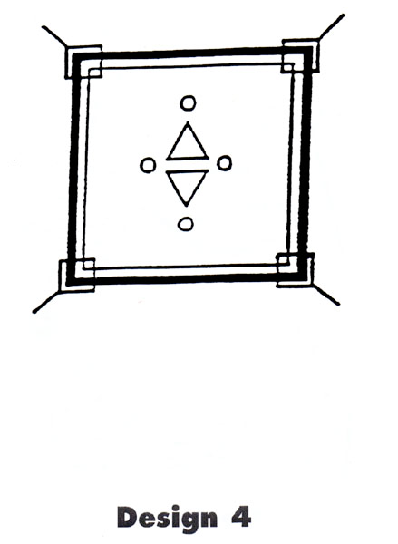
Notes:
30-seconds to look at

Slide 57
1 minute to draw
Notes:
So how did you all do when the information was organized?

Slide 58
17766024365911
Notes:
30 seconds – go

Slide 59
Now
Write the # from memory

Slide 60



Try again but think…
American Revolution/Declaration of Independence
Minutes/Hours/Days
Emergency
Notes:
30 seconds

Slide 61
1776
60-24-365
911

Slide 62
Visual Tool Examples
Graphic organizers
Text structures and features
Closed captions
Film and visualization
Reading scripts of plays and movies
Notes:
Based on our little experiment – can everyone see how visually structuring our exposure to materials can help us make sense of them and make them meaningful?

Slide 63
Finding the Main Idea
Enhances the meaning of all the sentences
Increases ability to remember the key ideas
Helps with organizing ideas and skills such as summarizing and note-taking
Enables retelling or writing about what was read in an organized manner
Notes:
We have been talking about narrative text exclusively so far today.
We need to make a few points about expository text, though.
While the factual nature of expository text can make comprehension easier for our ASD students, there can still be challenges.
One is finding the main idea.
Some readers explain that all the sentences of a paragraph appear equally important to them. It is like highlighting all the sentences in a paragraph. Nothing stands out.
When the main idea is not identified, there is no cohesion to the group of sentences and meaning is compromised. When the main idea is identified, the student can see how other sentences provide support for the main idea or clarify… the student can see how all the sentences fit together
Without understanding the main idea, the reader may try to remember too many details or focus on unimportant details, or remember nothing at all
Research shows that the retelling of students with ASD is noticeably different from that of others. Their responses tend to be superficial and lack the relevant main points and important details. They miss the gist of ideas.

Slide 64
Finding Main Idea Practice
Social Studies lesson:
  Write each sentence on a strip of paper
  Arrange the strips in order so the sentences flow
  Ask the student to remove the first strip and read the paragraph
  Continue removing sentences one at a time and rereading
Notes:
One activity consists of deciding, by process of elimination, which of the sentences is the main sentence.
After reading the paragraph without the sentence, replace it and remove the next one.
This process will help the student identify which sentence needs to be there to provide cohesion and meaning
This can also be done with a word processor where the student highlights and cuts one sentence at a time. After reading the paragraph without the sentence, paste it back in.
Ask the student which sentence is central to the meaning
Let’s look at the next slide and then put the activities together.

Slide 65
Highlighting the Main Idea Practice
Underline with a pencil when learning
Copy text and practice with highlighters
  Main idea in one color
  Supporting ideas in another color
Color-code ideas using a computer
In text, highlight the main idea in each paragraph
  If word processing, copy and paste main ideas from each paragraph to create a summary
Notes:
Show the class how to use the paper strips cut, use of computer to cut and paste, use of highlighted features
Then the student has a built in study guide

Slide 66
Graphic Organizers
Structured way to stimulate relevant prior knowledge
Visual representation of relationships among ideas
Examine characters, plots and relationships
Tool for generating written descriptions and summaries
Use of computer may be motivating
Notes:
We know the benefits of graphic organizers.
They can be helpful for students who have difficulty organizing what they read.
These students will not know how to use them effectively, though, without explicit instruction.
Emily Iland recommends matching the skill deficit of your student with the graphic organizer you choose. (ie sequencing, w questions, characters, etc.)
Then, teach them how to use it.

Slide 67
Graphic Organizers
Preselect the graphic organizer, matched to the text and your purpose
Explicitly teach the skill
  What a graphic organizer is
  What it is used for
  Why it helps to use one
Model use of the organizer
Conduct guided practice
Notes:
Choose the graphic organizer based on the purpose.
Key skills that are weaknesses in students with hyperlexia are listed in the handout: ** Hand out the Graphic Organizers strategy list**
Initially, choose familiar material of high interest so the student is only learning one new thing – the skill – rather than also trying to understand unfamiliar content.
Model or demonstrate the use of the organizer on a board, overhead or computer while students fill out individual copies
Guided practice – students are supported to fill in their forms until they are able to work independently

Slide 68
Graphic Organizers
Access prior knowledge
Preteach basic factual concepts
Prepare primer passage
Read text
Relate title, primer passage and text
Notes:
Graphic organizers are visual tools used to organize information and show the relationship between concepts.
Use of graphic organizers is recommended by the National Reading Panel as an effective way to improve comprehension for the average reader.
SmartArt with Windows 2007 has different types of graphics that can be inserted into Word documents or Powerpoint presentations, there are a variety of configuartions, some will show you circular diagrams some linear…
So, let’s look at our expository text.
So, in preparing to teach this lesson, I’d again access prior knowledge and teach vocabulary words. For expository text, my primer passage would be the headings.
I can do it in a list or I can use SmartArt and make a graphic organizer.
I can then demonstrate cutting a sentence out of each paragraph to see what the main idea is. I can then copy and paste it into my summary.

Slide 69
Text Organization
Newspapers
Magazine articles
Scripts
Instructional manuals
Novels
Textbooks
Notes:
Each type of material has a different purpose –
Share current news
Inform
Entertain
Teach
Each has a predictable style of organization

Slide 70
Text Features
Headlines
Photographs
Sections
Headings to cue reader what to expect
Bold or italic print
Patterns for expository and narrative
Notes:
Text is organized through the use of text features.

Slide 71


Slide 72
Text Structures
Concrete and predictable
Contain visual cues
Headings create a visual framework
Headings show the order and flow of the material
Text structures for narratives provide a framework for understanding story elements and plot

Slide 73
Why Preview Text Structure?
Helps identify the main idea
Gives a sense of the order and length
Gives the reader a sense of the purpose of the text
Text features, such as key words, can be targeted for learning vocabulary before reading

Slide 74
Text Structure
Stimulate relevant prior knowledge
Explain the type of text structure
Select a short sample text to identify the text structure element in context
Provide materials for guided practice
Follow up with opportunities to generalize the skill to a variety of reading material
Notes:
Explicitly teach text structures. Again, use practice materials that are familiar and of high interest so the student is only learning the new skill.
After you select the text with the structure you want to teach:
Stimulate prior knowledge of text structures the student is already familiar with and uses
Explain what it is used for and why it helps the student to use it. Provide examples
Select a short sample text to identify the text structure element in context, explain what it is and make the connections with the text to demonstrate its usefulness

Slide 75



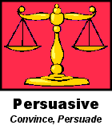
Text Type/Author’s Purpose
Notes:
Each document/source will have a different text organization or structure.

Slide 76
What are Text Structures?
Organizational patterns in writing
-Description
-Sequence
-Problem and Solution
-Cause and Effect
-Comparison and Contrast
Notes:
Examples given from the literacy leader power point

Slide 77
Why is text structure important?
“Many students experience
problems comprehending
expository text….One reason is
that they can’t see the basic
structure of the text. Some
students get lost in the words and
can’t see the big picture.”
Dymock, 1998; Dymock & Nicholson, 1999
Notes:
From the literacy leader power point

Slide 78
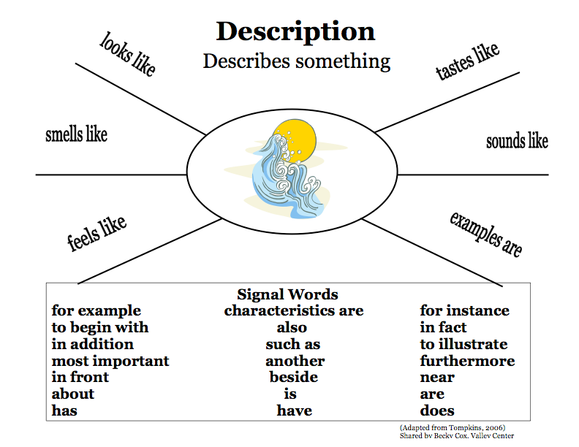
Notes:
One idea for identifying the organization, the features, and the structures of a text - From literacy leader power point

Slide 79
FCRR
Florida Center for Reading also gives a great pdf attached that uses graphic organizers for different text structures to assist with comprehension.
Take a look…
www.fcrr.org/curriculum/PDF/G2-3/2-3Comp_1.pdf

Slide 80
What’s the goal for teaching text organization, features, and structure?
For students to internalize their knowledge about text structure and use it to enhance their comprehension.
&
To teach student to use text structures to improve their reading comprehension and writing organization.
Notes:
As written best on slide 80 of the literacy leader power point…

Slide 81
Previewing Text
Explain why we preview
Explain what previewing is
Relate previewing to something known
Model previewing with a book walk
Check for understanding
Conduct guided practice
Support independent practice
Support generalization
Notes:
Also called a story walk or a picture walk
Students with ASD have a hard time with prediction. Previewing may help them perceive the order and sequence of events
* We preview to get an idea of what the material is about and how it is organized
* Previewing improves understanding, helps us get ready to read by looking at the material and getting a general idea
* A movie preview gets our interest, lets us know the main idea, the theme and what type of movie it will be (comedy, thriller, drama, fantasy)
* What is happening in this picture? What will this story be about? For books without pictures, review text organization and layout – headings, chapter titles, etc.
* Ask what material will be covered in a specific section based on heading, word in bold print….
* Think aloud as you guide students through the reading material. Ask students what will be important based on the clues they see (headings, bold words)
* Start with a short book the student prefers. Demonstrate the skill using preferred material. Move to an unknown text on a similar theme
* Move to unfamiliar reading material at an easy reading level and then move to more difficult material as skill is mastered.

Slide 82
Closed Captions
Visual presentation supports auditory comprehension of oral language
Improve self-monitoring
Multiple and repeated exposure to words and ideas
Help with spelling
With music, expand world knowledge
Notes:
Many students with ASD have difficulties with auditory processing and miss some spoken language. Seeing discrete words may help the reader realize “Oh, That’s what they’re saying!”
Help self-monitoring as the reader follows along
When favorite videos are replayed,
For students with strong visual memory
Many times the artist and name of the music is displayed

Slide 83
Closed Captions
Bring the captions to the student’s attention
Explain some of the advantages of paying attention to closed captions
Pause the show at different points to reinforce the meaning or relevance of the captions
  www.edutube.org/additional-info/has-subtitles-english
Notes:
Steps to teaching – lets check out a website. Make sure you turn off your pop-up blocker.

Slide 84
Film & Visualization
Creates specific, concrete background knowledge
Engage interest and attention
Easier to understand familiar than unfamiliar
Borrow visual images from the filmmaker
Opportunities for socialization
Notes:
My favorite! Much of the information about a topic, character or historical period is presented visually, language-free
Exposure through film can clarify descriptions, objects and concepts. Individuals with ASD are reported to miss the “gist” or point of static photographs or focus on the wrong details
Given the difficulty creating visual images if they have not experienced an event, the reader has something concrete to visualize while reading
Develop common experiences and interests – form friendships through areas of shared interest

Slide 85
Film & Visualization
View the film in segments & read corresponding chapter
Point out specific descriptions in the book
“Think aloud” to discuss what images you envisioned from the text were different from the ones in the film
Notes:
Often we view the film after the book – it is very helpful to watch before the chapter is read so that the student can borrow a visual picture of what is taking place as they read.

Slide 86
Film & Visualization
Draw a scene from the film that they liked
Encourage the student to create images while reading like the movie maker did
Discuss differences between the student’s mental images and the filmmaker’s
Discuss differences between the book and the film
Notes:
Research with students with ASD shows that talking, writing and drawing pictures about stories can reinforce comprehension – for students with good fine motor skills
Make your own movie in your mind
In more advanced classes, you can discuss the differences and teach about artistic license in filmmaking and the filmmaker’s perspective

Slide 87
Reading Scripts of Plays & Films
Scripts reveal the thoughts and feelings behind the plot and characters
Scripts overtly state the reactions of characters to each other
Nonverbal cues, physical actions and demeanor of the actor are clearly spelled out
Acting out scripts is a cooperative activity
Students can experience interacting with characters, actions and plots
Interactive social experience
Notes:
As a pre-reading strategy, reading scripts can be active and engaging. Taking turns reading dialogue aloud can enhance meaning and understanding. Younger kids Reader’s Theatre

Slide 88
Reading Scripts of Plays & Films
Compare a chapter in the book to a scene in the play looking for similarities and differences
Explore emotions and perspective taking
Teach concept degrees of emotion by having students reenact the same scene
Notes:
Start small and be selective. Choose the story and scene with the most learning potential – are you targeting verbal and nonverbal cues, their perspectives of the characters, cause-and-effect, descriptors of emotional level?
Follow the same steps as comparing a movie and a book
Students can look at what was cut from the book to make the play and why – students may agree or disagree
Select scenes from the play where a clear emotional component is described
Assign a degree of emotion to different groups. Use language to describe how to use facial expression and body language to express different intensities of emotions. When reading the script, students can look for clues in the text that hint at the emotional level

Slide 89
Finding Scripts
Check out Reader’s Theatre (Prescott, 2003)
  http://teachingheart.net/readerstheater.htm
  www.imsdb.com/genre/Family
  www.simplyscripts.com/
Notes:
Also located in your list of websites.

Slide 90
Building Vocabulary
Little research on what works to build vocabulary for readers with ASD
No vocabulary intervention studies that include readers with ASD and hyperlexia
Parents and professionals needs to be selective when choosing techniques and tools as each student with ASD is different
Notes:
Readers with hyperlexia – and many students with ASD – tend to word call. They do not interact with , relate to or hold onto the meaning of the word being read. They identify a word without understanding what it means. As a result, they don’t add new words to their personal vocabulary the way the rest of us do. The meaning of a new word is not stored in their memory.
Incidental learning (picking up words through casual exposure) doesn’t happen with students with ASD as it does with neurotypical students. Again, their interests and, as a result, their vocabulary, is narrow and deep rather than wide and diverse.
Direct, explicit instruction of unfamiliar and key words is necessary before reading.
This is another area where there is little research on what works to build vocabulary for readers with ASD and no vocabulary intervention studies that include readers with ASD and hyperlexia.
Emily Iland has done extensive research. Her book lists suggestions on guidelines to teach word meanings to students with hyperlexia and ASD and they are located on the general guidelines for teaching vocabulary handout in the resource materials.
Temple Grandin in her book “The way I see it” discusses the idea of up and down concepts. Develop short sentences using the vocab word to given mental pictures of the word. For example: Stars are up in the sky. The squirrel is up in the tree. You throw the ball up in the air.

Slide 91
Building Vocabulary
Seven strategies that Emily Iland gives are as follows:
  Teaching vocabulary through synonyms
  Electronic dictionary
  Using objects to teach vocabulary
  Visual Dictionaries
  Connotation: Shades of meaning
  Word Elements
  Homographs

Slide 92
Using Synonyms to Teach Vocabulary
Via the computer/technology…
Teacher-Directed Activity
  Identify vocabulary words to be taught
  Type them into Word document
  Right click
  Choose Synonyms
  Ask the students to identify synonyms
  they recognize
  Read the passage using the synonym and then the actual word
Notes:
I was able to scan the text of Charlotte’s Web to a Rich text format that opened in Word. It’s not real accurate, but…
In lieu of that, typing phrases or sentences with key words would allow you to demonstrate this technique

Slide 93
Independent Student Activity
  1. Type a selected text into a word processing document
  2. The student pre-reads the text and uses the word processor’s highlight tool to identify unknown words
  3. For each highlighted word, the student right-clicks the computer mouse
  4. From the synonym list, the student clicks on a word that he/she recognizes and knows the meaning of
  5. The student reads the text with the substituted familiar words
  6. Student and teacher check for understanding of the passage with the synonym
  7. The student re-reads the original text and teacher checks for understanding
Notes:
Computer-based activities engage learners – especially those on the spectrum.
Many students with ASD prefer keyboarding to handwriting
This activity builds on “the known” to create meaning
This method addresses pre-teaching, vocabulary, self-monitoring skills and the use of context
The reader is able to maintain the train of thought without being distracted by a dictionary
This is a useful tool for lifetime reading
If the student does not know the meaning of any of the synonyms, sometimes they know the meaning of the antonym
A thesaurus option is also available.

Slide 94
Generalizations & Applications
Students create a personal dictionary or thesaurus and may find visual images or clip art to accompany the words
Use this process for a single word to fast access the meaning of a word when reading
Use this process in reverse. Type in a known, “ordinary” word and click to select more powerful or interesting words

Slide 95
Electronic Dictionary
Choose Dictionary or Thesaurus
Type the word
Notice if the word has multiple meanings and, if so, notice the part of speech (e.g., noun, verb, adjective)
Explore bonus features (e.g, “speak” function)
Notes:
Advantages
Small, portable and user-friendly allowing rapid clarification of word meaning
Once the routine is learned, it can be used during any type of reading task
May be used to clarify the meaning of a spoken word during a lecture or presentation
Readers with ASD may have good prerequisite skills such as identifying the parts of speech that allows them to select the appropriate meaning (if not, teach this skill before using this strategy)
It is an accommodation that helps the student fit in with the peer group as it is a “cool” technology
Steps
When I got my “smart” phone almost a year ago, I knew it was smarter than I was and downloading the dictionary app seemed like a good idea. It wasn’t until I was going through Emily Iland’s book that I realized what it could do….

Slide 96
Generalizations & Applications
Lifelong tool
For students with a related disability, it is an allowable accommodation for high-stakes tests
Even young students are savvy with electronic devices
May encourage use of e-book readers using their built-in tools
Notes:
Electronic dictionaries, if included in your student’s IEP, can be used for high-stakes tests. Mrs. Iland’s son was able to pass his CPA exam with the help of his electronic dictionary. Apparently, the examiner’s provide the electronic dictionary so it is important to find out which one they use so the student can practice with it.

Slide 97
Using Objects to Pre-Teach Vocabulary
Preview the text
Identify unfamiliar, important objects or items
Obtain as may items as possible
Display items and give students chance to experience them
Verbal explanation of item and its purpose
Present the text
Notes:
Advantages
Greater ability to create meaning and grow vocabulary than reading definitions or even viewing pictures
Concrete and visual way to grow vocabulary of nouns, adjectives and verbs as, when handling objects, students discuss characteristics, - describe features, characteristics and details of items – use senses – see, feel, smell, touch, hear (taste when appropriate)
Creates a visual memory
Historical societies can be helpful.
What items would you find to for Charlottes web chapter one?

Slide 98
Generalizations & Applications
Introduce item with a game using a multiple choice or matching format
Activities that focus on descriptions and attributes
Students share objects of particular interest to them with classmates
Notes:
To access prior knowledge if a student is “drawing a blank”, players ask
“What do you think this is?”
“What do you think it does?”
“What do you think it is called?”
“What name would you give it?”
Multiple choice or matching format will be helpful for our students who “draw a blank”.
2. To reinforce, a student can create a set of objects that are key to a story of high personal interest and share those with classmates…
Or create his own matching game to discuss
“What do you think this is?”
“What do you think it does?”
“What do you think it is called?”
“What name would you give it?”
The student shines by focusing on an area of interest… May need guidance in perspective taking to make sure the other students would be interested in the topic or objects
Students may expand their vocabulary beyond their own area of interest

Slide 99
Visual Dictionaries
Model use of visual images
Select words to teach students to search for visual images
Notes:
Readers with ASD have a hard time creating visual images in response to spoken or written words.
Einstein is quoted as saying, “If I can’t picture it, I can’t understand it.”
Advantages
Statistics suggest that a students needs 12 meaningful exposures to a word to be able to understand it. Searching for computer images is concrete, meaningful and motivating
May help create connection between descriptive text and real objects
Use language to describe attributes…. Grow vocabulary
Google images describes itself as “the most comprehensive image search on the web”
If “free use” of the Internet is not advisable, use the image search tool with greater control.

Slide 100
Directions for Visual Dictionary
The internet and word processing programs provide a wealth of opportunities to help our students create visual images and understand word meanings.
  Create a Word document
  Type the vocabulary words you want in your picture dictionary
  Under My Pictures, Create a file for the book
  Access internet image site such as http://images.google.com
  Enter images into search bar
  Select thumbnails you prefer
  Double left click to make it a .jpg image
  Right click to Save As
  Enter it into your file folder
  In your Picture Dictionary, Insert Picture
  Size and position as needed
Notes:
Activity: Create a visual dictionary for chapter one of Charlottes web chapter 1.

Slide 101
Generalizations & Applications
Worksheet that matches words with pictures
Word Detective Game: Riddle with 3 visual choices
Teams of students are given a sentence with a key word highlighted. Each team finds the image and explains why their image is correct. Team results are imported into a single document.
Create Power Point presentations of vocabulary from text
Notes:
Ideas suggested by Emily Iland for use in the classroom
Any questions so far?

Slide 102

Take 5

Slide 103
Connotation: Shades of Meaning
Start with a very familiar key word such as fun and 4 synonyms (e.g., enjoyable, exciting, awesome, amusing).
Write the words on the paint chip according to the intensity of meaning
Explain that connotation refers to the feeling behind the words
Select other connotative synonyms from text
Notes:
Advantages
Explore theory of mind – understanding the thoughts and intentions of the author and the purpose in selecting specific words
Concrete way to teach implied meaning and inference at the word level – may be a foundation for developing awareness of other types of inference
Many people with ASD like to make lists and may learn to rate words as positive, negative or neutral
May help them vary their word choices when writing
Connect the concrete visual cue with word meaning
Ask the students to think about something they like and relate to personally – a video game or activity they really like. Then think about words to describe something that is “kind of fun” and words to describe something that is “really, really fun”.
“lightest” is least emotional or least strong - “darkest” is most emotional or most strong
They have just ranked the words in order from weakest to strongest feeling or connotation. Select more key words from areas of high interest such as favorite foods or television shows
Use the right click synonym to find synonyms for key words in text

Slide 104
Connotation
ACTIVITY TIME

Slide 105
Connotation: Shades of Meaning
Key points about connotation
  Connotations are subjective
  People may react differently to words. It is okay to have different opinions.
  An author’s word choice reflects his perspective
  Intentionally choosing words with particular connotations given extra meaning and are a powerful communication tool
  People use connotation when speaking, too, to add special meaning
Notes:
Different people can have different feelings or responses to the implied meanings
People’s experiences and perspective may cause people to react differently to words. They may rank the intensity differently
The author is choosing a word that is intended to be positive, negative or neutral
People use connotation in real life just as the dialog of characters in stories

Slide 106
Generalizations & Applications
Reader may become alert to word choice and be aware of the intention of the author
Reader may understand a word conveys meaning and feeling
May transfer this skill to speaking
Gains in socialization and communication can improve literacy and comprehension
Notes:
What to say? And Emily Island activity, Is another sample activity.
Other ideas could include using ads – or political campaign rhetoric
There are several gains to learning shades of meaning and connotation.
Benefits may transfer to reading, writing and speaking
Clearly, this skills would have a positive impact on a student’s language development and social interaction.
Improvement in these areas enhances reading comprehension

Slide 107
Word Elements
Explicitly define a prefix
  It is a group of letters that go in front of a word
  It changes the meaning of the word
  When you take it away, a word is left
Focus only on negative meanings of un- and dis- which mean “not”
Introduce 4 more prefixes that mean “not” – in-, im-, ir- and non-
Notes:
Suffixes (morpheme added to end to change or form a derivative, Affixes (add to beg or end of word to change meaning), Root Meanings (word or word elements from which other words grow) – prefixes and suffixes
The most common prefixes and suffixes for nouns and verbs are included in your handouts.
The steps for teaching recommended by Emily Iland are
Again, be explicit
Advantages:
Meanings are clear, concrete and predictable
Uses skills such as rote memory and repetition
May find it easy to memorize the meaning of may of the prefixes, suffixes and root words
May enjoy making lists and categorizing
May link to math – breaking whole into parts or using parts to create a whole

Slide 108
Word Elements
Introduce 2 different meanings of the prefix re-, back and again
Revisit other meanings of un- and dis- (do the opposite), as well as in- and im- (in or into)
Introduce other prefixes: en-, em-, over-, and mis-

Slide 109
Generalizations & Applications
Practice the skill with words in student’s area of interest.
  Latin roots linked to Harry Potter Magic Spells at http://www.ehow.com/how_4602032_latin-root-words-magic-spells.html
Personalize what the word part means
Use objects of high interest such as toy cars, toy trains, blocks or manipulatives

Slide 110
Additional Website
www.prefixsuffix.com

Slide 111
DISSECT Mnemonic
Discover the word’s context
Isolate the prefix
Separate the suffix
Say the stem or root word
Examine the stem or root word
Check with someone
Try the dictionary (for our students, dictionary alternatives)
Notes:
(Tim Rasinski – Read naturally) Why?
Research shows mnemonics are effective memory-enhancing tools because they rely on memory for pictures, acoustic memory and promote recall
Supports active, dynamic thinking practiced by good readers – gives them a step-by-step process to follow
Particularly useful in Science and Social Studies
Additional resources are listed in your handouts

Slide 112
Homographs
Contract
Does
Contest
Object
Dove
Notes:
Homographs are words that are spelled the same but have different meanings. The meaning of the word is changed significantly depending on how it is pronounced.
Sometimes, a different syllable is accented
Usually, they are 2 different parts of speech – one is a noun, one is a verb
Some single syllable words are homographs

Slide 113
Readers with ASD
Struggle with homographs
Have difficulty using context
Do not clarify when things do not make sense to them
Do not monitor their own understanding as they read
Notes:
** page 17 & 18 of Iland pdf the one with the owl on it.**
Here we have research that shows:
Readers with ASD typically use a word by word reading strategy rather than integrating the words into whole thoughts and ideas as they read.
They do not respond to context clues.
& they Do not listen to themselves and self-correct their error when they choose the wrong pronunciation
Given the importance of this, I made a copy of the detailed steps to teaching homographs and included them in your handouts. Again, she is explicit, models and generalizes.
Again, this is a task that lends itself easily to lists and tables. Encourage students to create a table that has columns for parts of speech: nouns, verbs, adjectives.
The student enters the homograph with the accent syllable in bold in the right column. Again, a personal dictionary is created.

Slide 114
Generalizations & Applications
Learn to use context cues to resolve ambiguity
Learn to self-monitor while reading
Pique interest – keep lists of homographs
Vocabulary development: MM words
Learn to read for meaning rather than word-by-word
Notes:
MM=multiple meaning words
Use/create a picture dictionary to show homograph differences. eg. dove= someone diving & dove=bird

Slide 115
Generalizations & Applications
Students write 2 homograph sentences or paragraphs and exchange them
Keep a list and encourage personal lists
Computer homograph game
  http://www.quia.com/cb/8285.html
Expand on the idea with multiple-meaning words
  http://www.ezschool.com/Games/Homographs.html
Notes:
The homograph game site has a subscription fee but a free trial is available
A free game of 50 multiple-meaning words is available at this website

Slide 116
Understand Passions
Identify key areas of interest
Use these areas to build skills in other areas
Fade time allowed for preoccupations
When introducing a new or difficult skill, go back to the area of interest briefly to help “sell” the new concept
Find ways to adapt passions to make them similar to interests of peers
Notes:
Understand and Use Passions, Preoccupations and Routines EX: Cereal Box learning**
May interfere with other learning, make student less available for new learning
So, How Can We Help?
Identify key areas of interest
Use these areas to build skills in other areas – reading USA after language assignment is done; use stock market to teach math
Fade time allowed for preoccupations while reinforcing student’s use of adaptive behaviors, flexibility and problem-solving (We all have to spend time doing things that are not in our area of interest)
When introducing a new or difficult skill, go back to the area of interest briefly to help “sell” the new concept
Find ways to adapt passions to make them fit in with peers
Remind students of connections between new and prior learning

Slide 117
Keep Your Sense of Humor
Humor helps to break the barriers of insecurity and establish a level on which all can relate.
Notes:
Humour helps to break the barriers of insecurity and establish a level on which all can relate
“For some of my students with social-cognitive deficits, the concept of using humor in school was novel and not initially welcomed. After all, we often inadvertently teach our already rigid students how to be more “autistic.” From early on in school we insist that “good” students are: quiet, obedient, and suppressive of impulses of humor in the learning environment. While we want all students to follow these general rules of conduct, we also want to the students to be relaxed to maximize their focus and minimize their anxiety.”

Slide 118
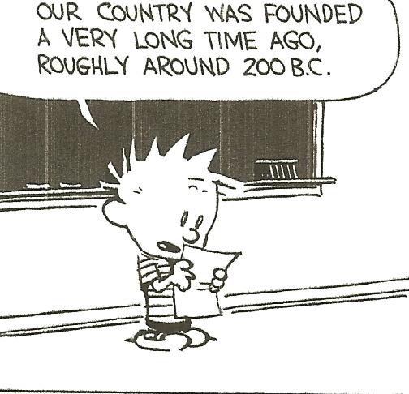

Slide 119
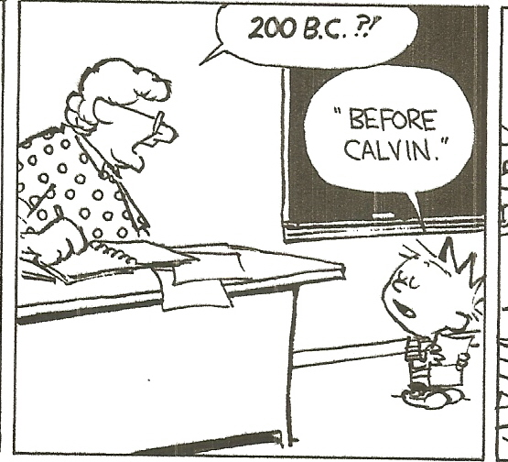

Slide 120
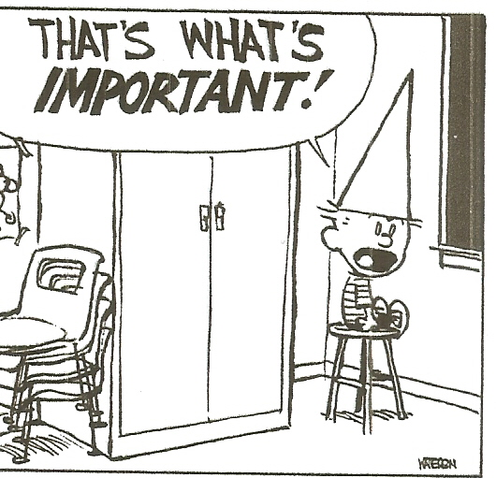

Slide 121
To Do:
Fill out Evaluation (Be Gentle)
Place Evaluation Forms in the basket.

